Slide 1
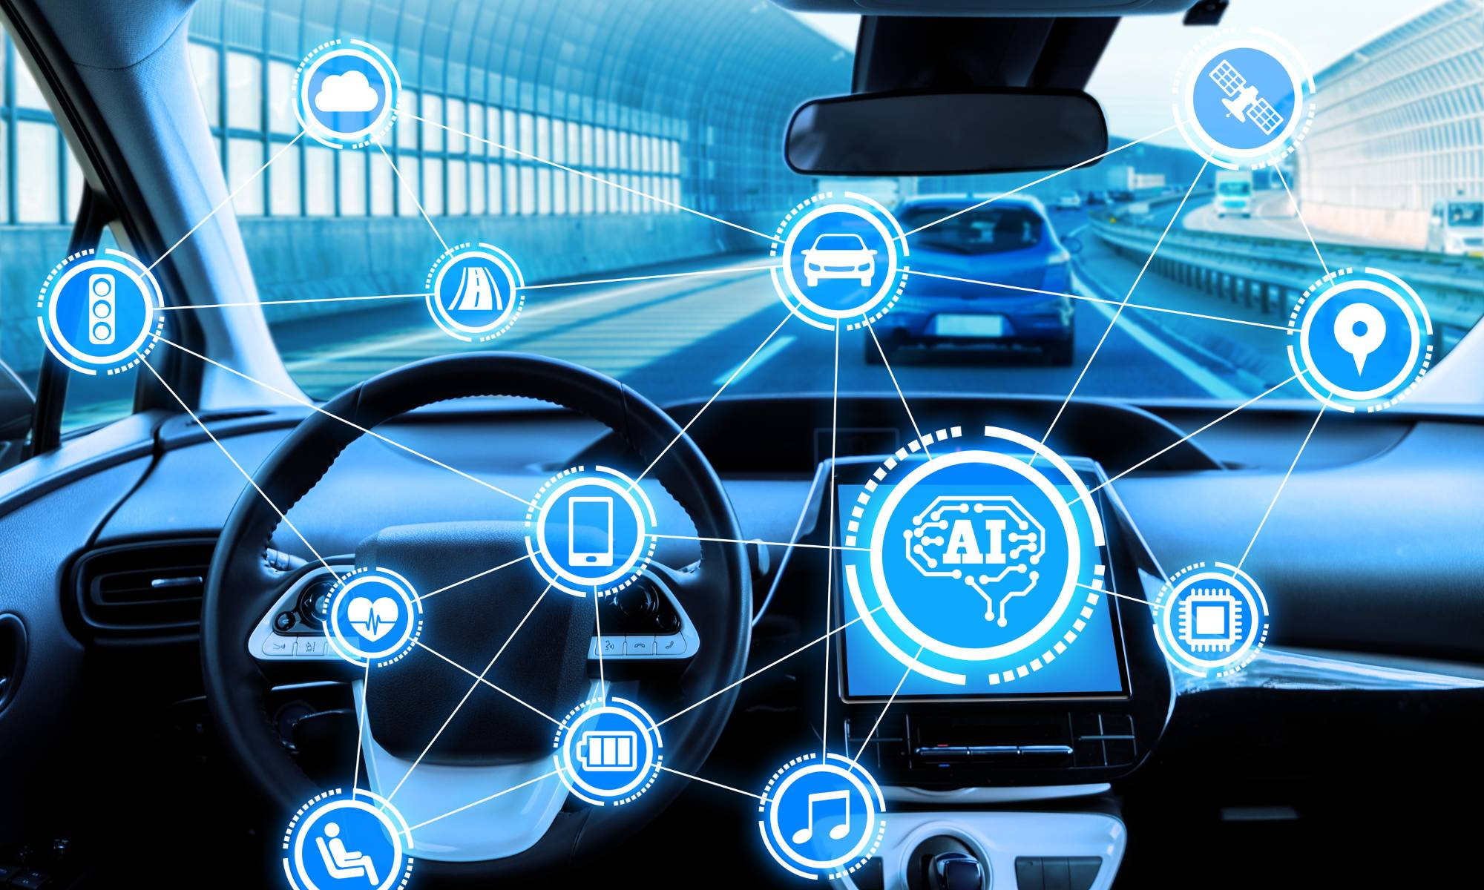

Source : https://pharmeasy.in www.ndtv.com

Slide 2
Challenges
Congestion Violation Management
Large vol: ~6 M
Avg speed:22k/h
Illegal parking, improper lane use, Crossing line and wrong way
Work load : 300k, process 30k-50k, lots of bline spots . Non AI camera

Slide 3
The Top Five AI Traffic Management Solutions
Intelligent Traffic Management System (IMTS)
Artificial Intelligence Monitoring System (AIMS)
Internet of Things (IoT)
Intelligent Traffic Congestion Classification System using Artificial Neural Network (ANN)
Intelligent Sensor-based Traffic Signal Management System
Notes:
data from traffic cameras is analyzed and can be used to identify and fine vehicles violating traffic rules
predict traffic jams, take measures to avoid traffic jams, decrease congestion by increasing the duration of green lights, diverting vehicles to less crowded routes, etc.
all the light poles on the road are connected using IoT, they can use sensors to detect an accident and communicate it to the highway authorities, police, and the nearest medical facility. Similarly, IoT can be used to adjust the duration of the green light according to the traffic density rather than the set time.
can be used to guide drivers to avoid congestion and hence ensuring efficient traffic flow
Schools in Germany are using this form of AI to ensure the safety of students crossing the road. When a student presses the button on a traffic signal indicating they want to cross the road

Slide 4
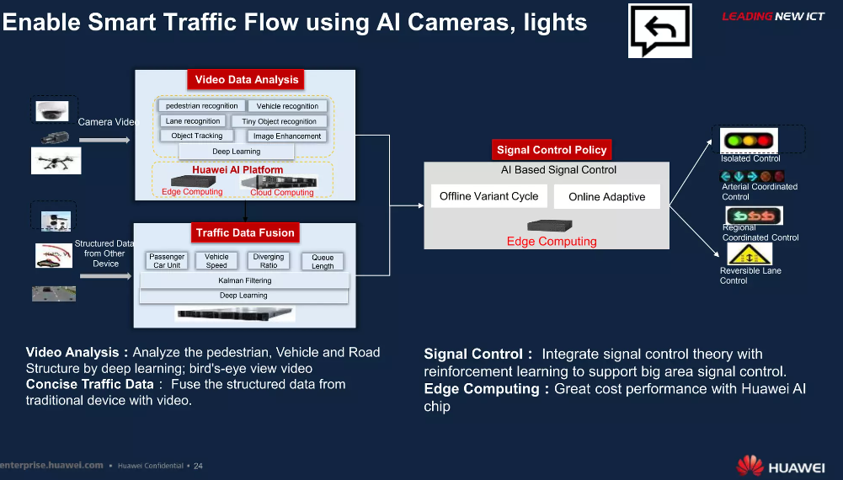

Slide 5
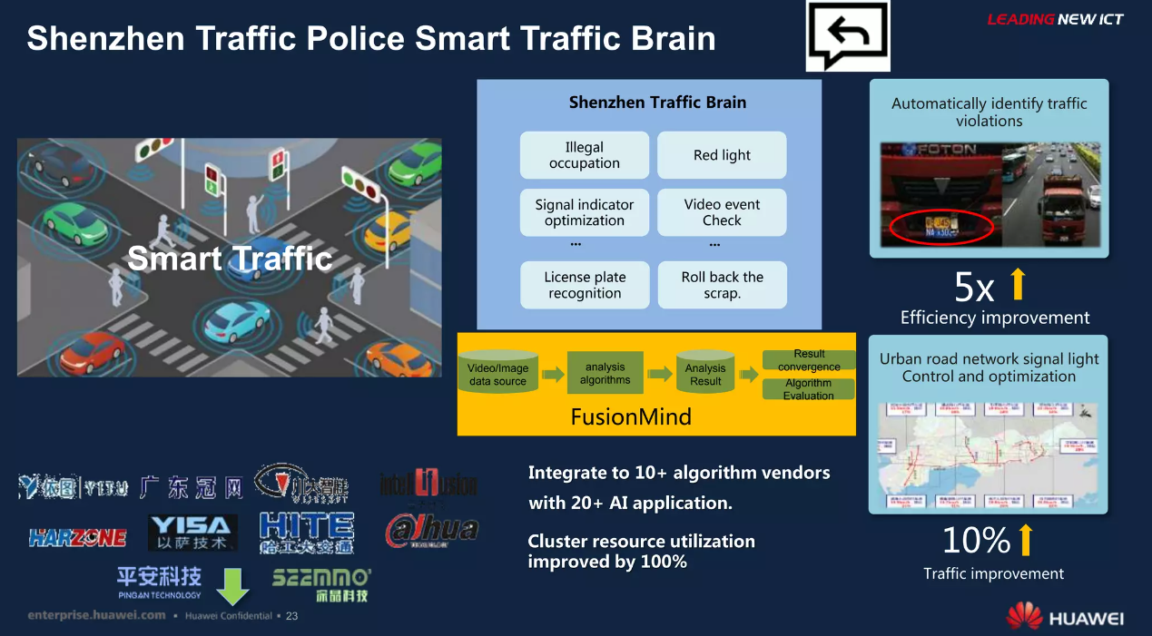

Slide 6
